Slide 1
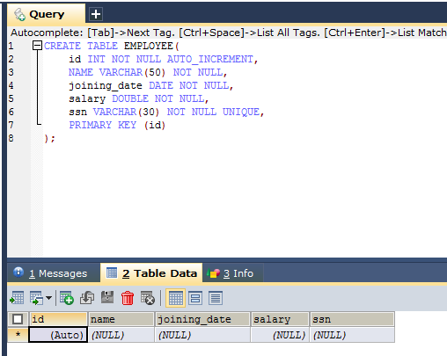
Spring 4 + Hibernate 4 + MySQL 8.0.14 + Maven Integration example (Annotation based configuration)
Create Schema in database

Slide 2
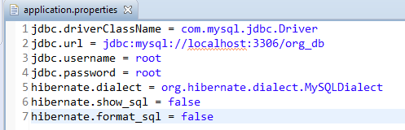
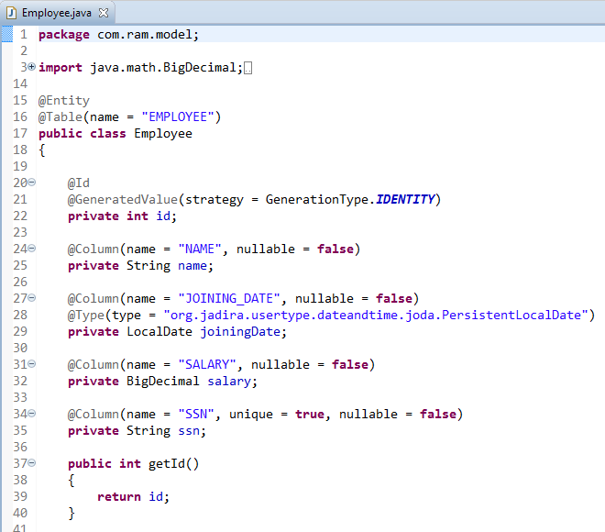
Spring 4 + Hibernate 4 + MySQL 8.0.14 + Maven Integration example (Annotation based configuration)
Properties file
Create Domain Entity Class(POJO)

Slide 3
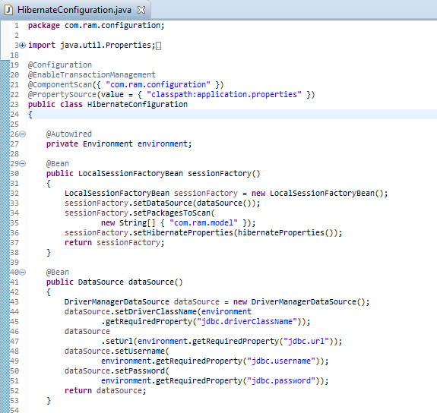
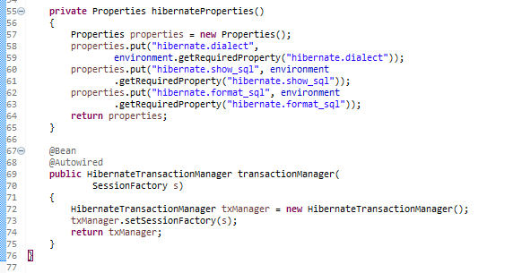
Spring 4 + Hibernate 4 + MySQL 8.0.14 + Maven Integration example (Annotation based configuration)
Configure Hibernate

Slide 4
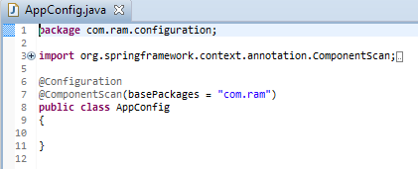
Spring 4 + Hibernate 4 + MySQL 8.0.14 + Maven Integration example (Annotation based configuration)
Configure Spring

Slide 5
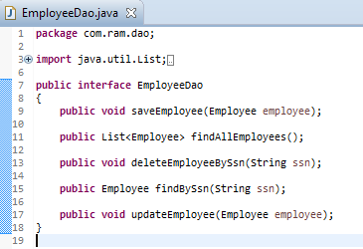
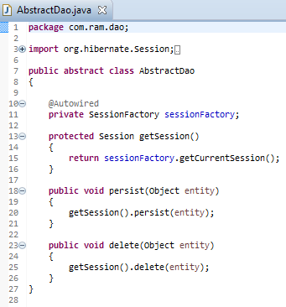
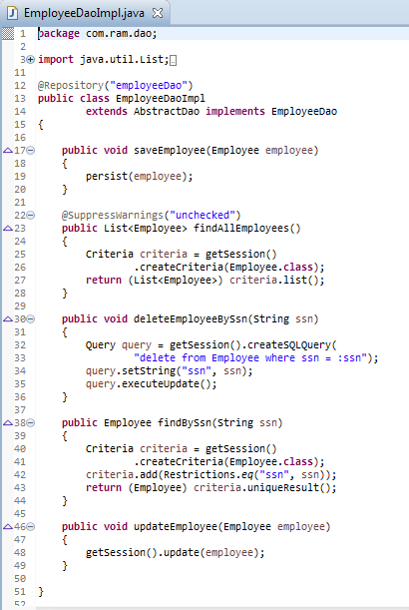
Spring 4 + Hibernate 4 + MySQL 8.0.14 + Maven Integration example (Annotation based configuration)
Add DAO Layer

Slide 6
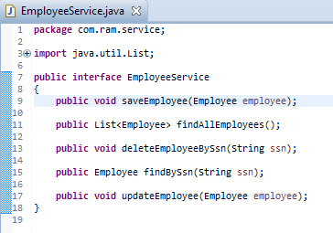
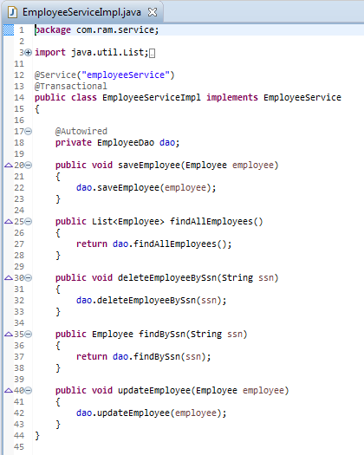
Spring 4 + Hibernate 4 + MySQL 8.0.14 + Maven Integration example (Annotation based configuration)
Add Service Layer

Slide 7
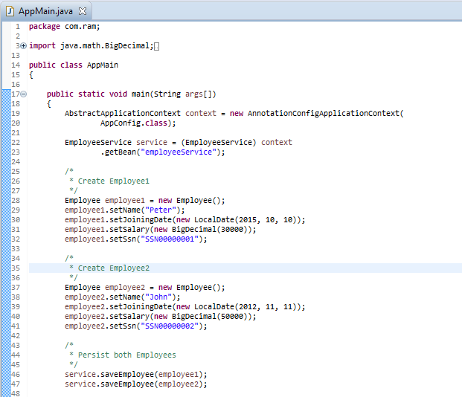
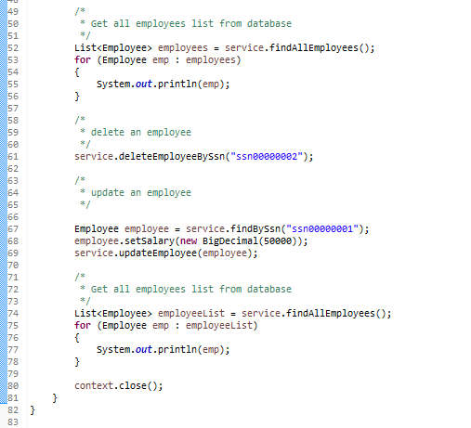
Spring 4 + Hibernate 4 + MySQL 8.0.14 + Maven Integration example (Annotation based configuration)
Create Main to run as Java Application

